Slide 1
Team 3 provisio
By: Avery Owen, Chee Her, Kyle Gotzman, Jonathan Sudhop

Slide 2
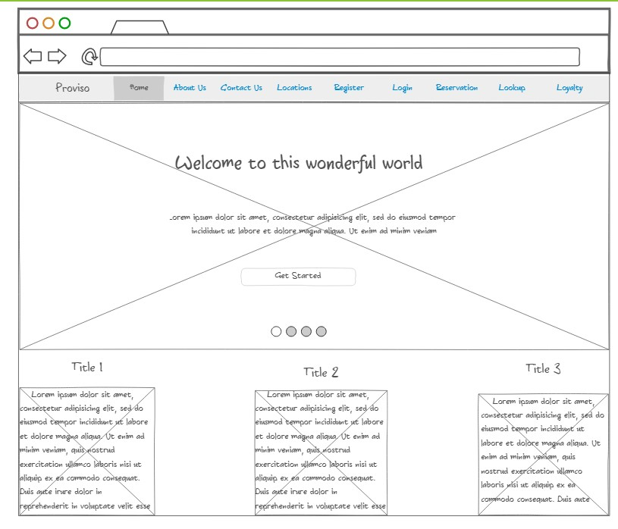
Home page prototype

Slide 3
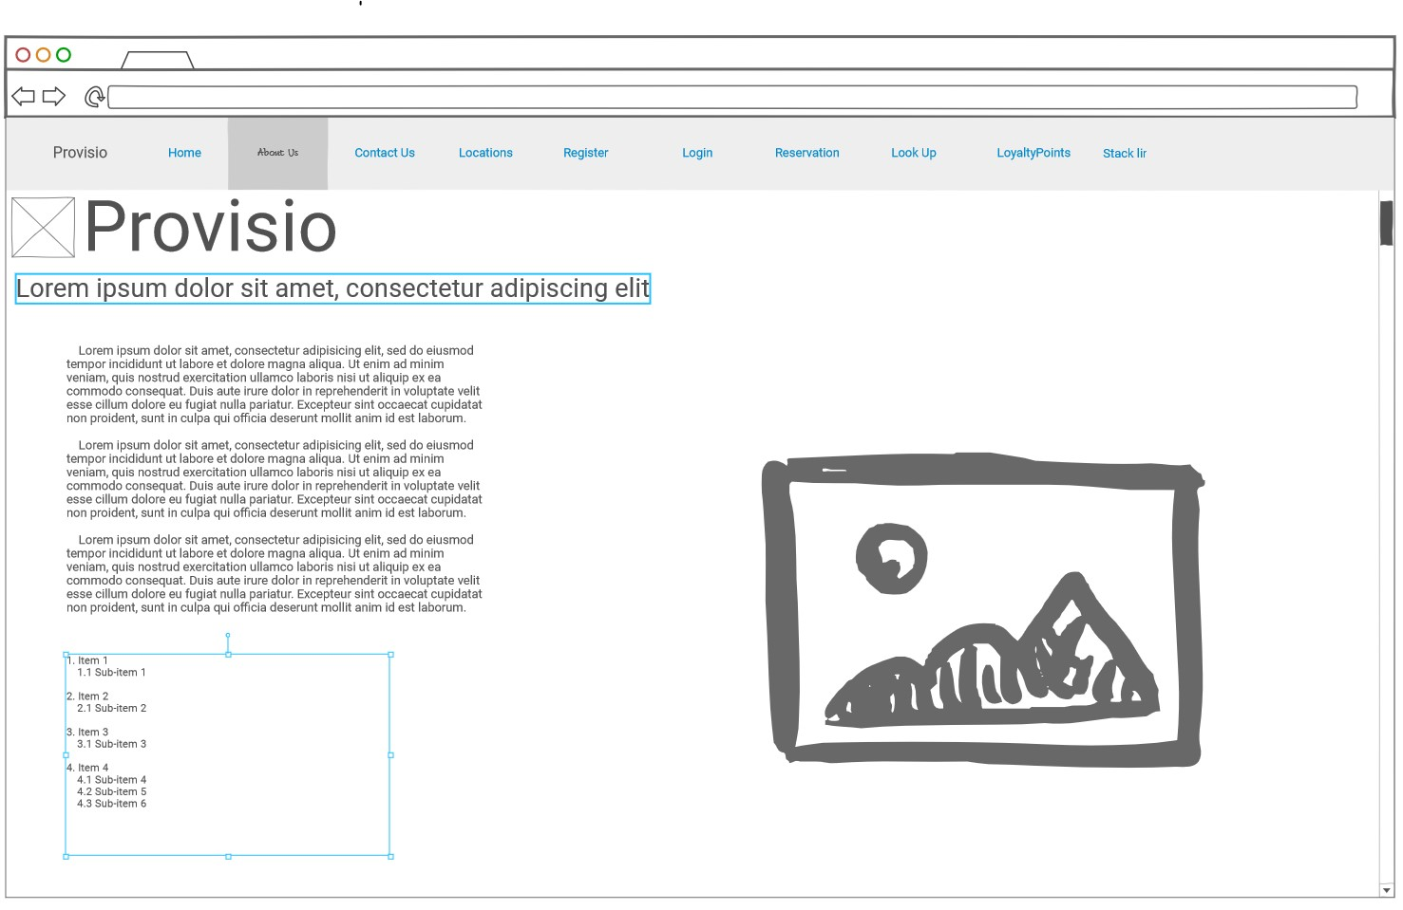
About us Page prototype

Slide 4
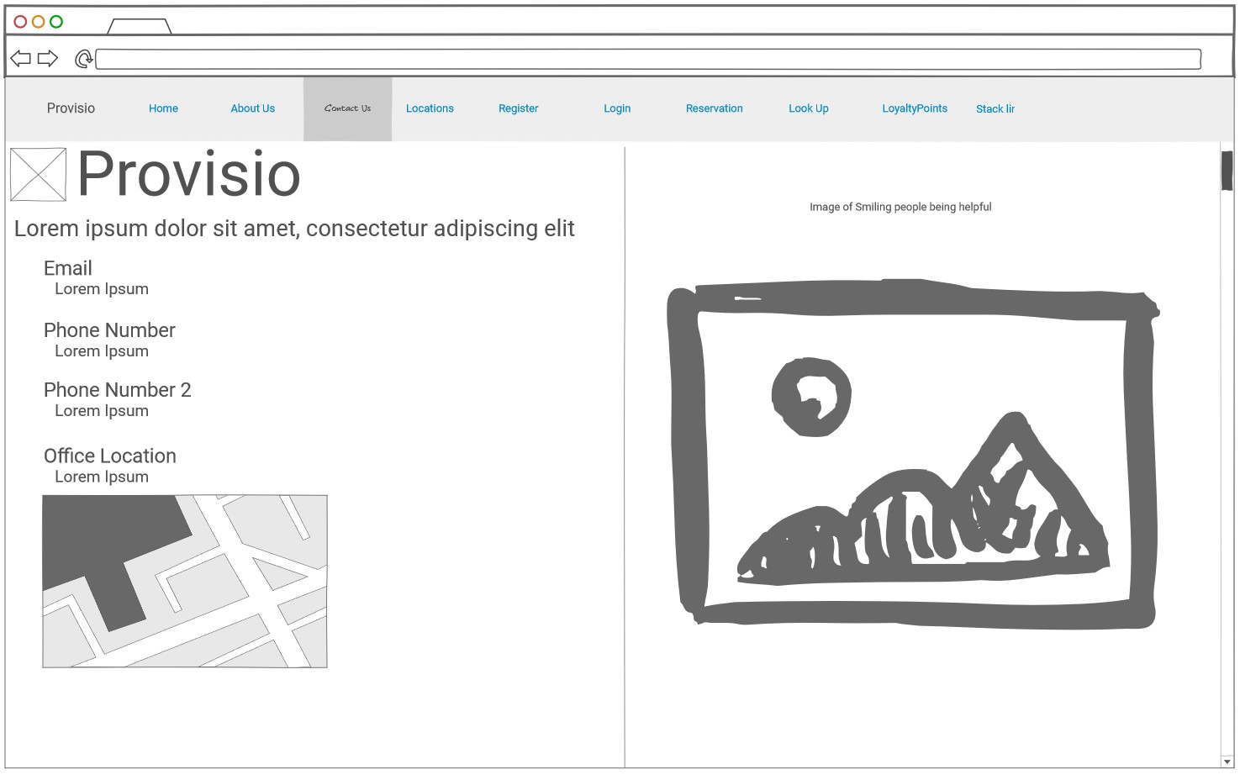
Contact us Page prototype

Slide 5
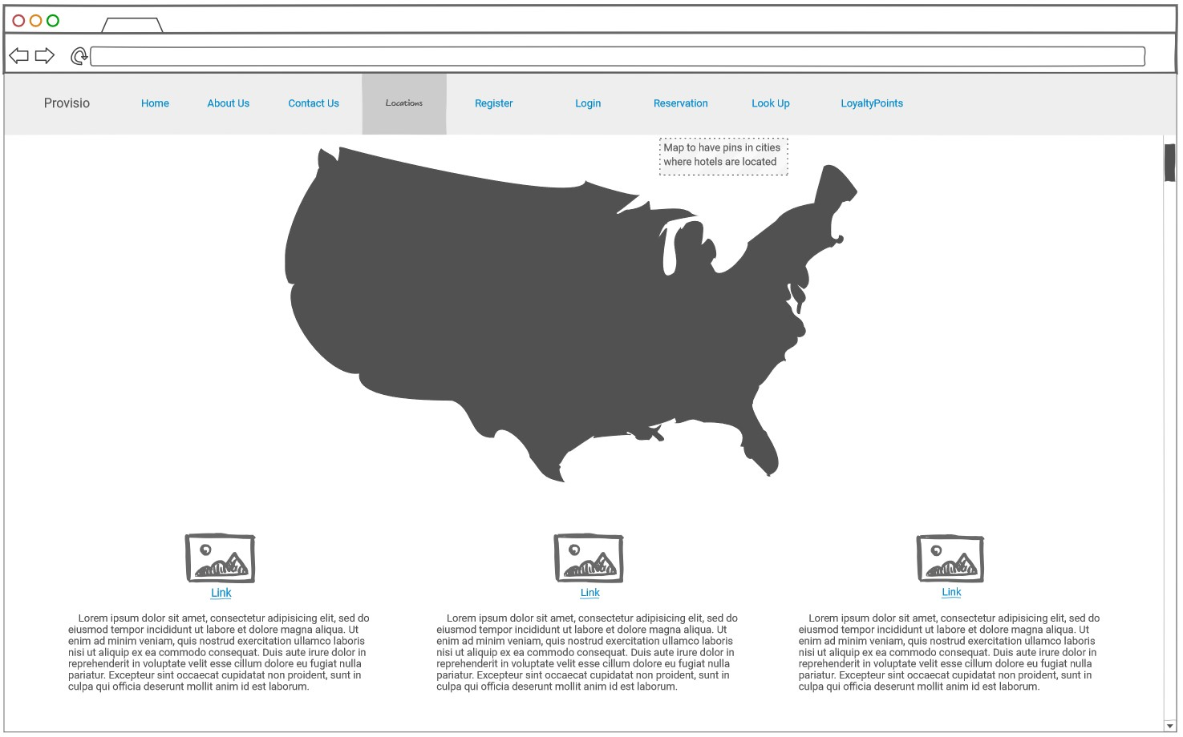
Locations Page prototype

Slide 6
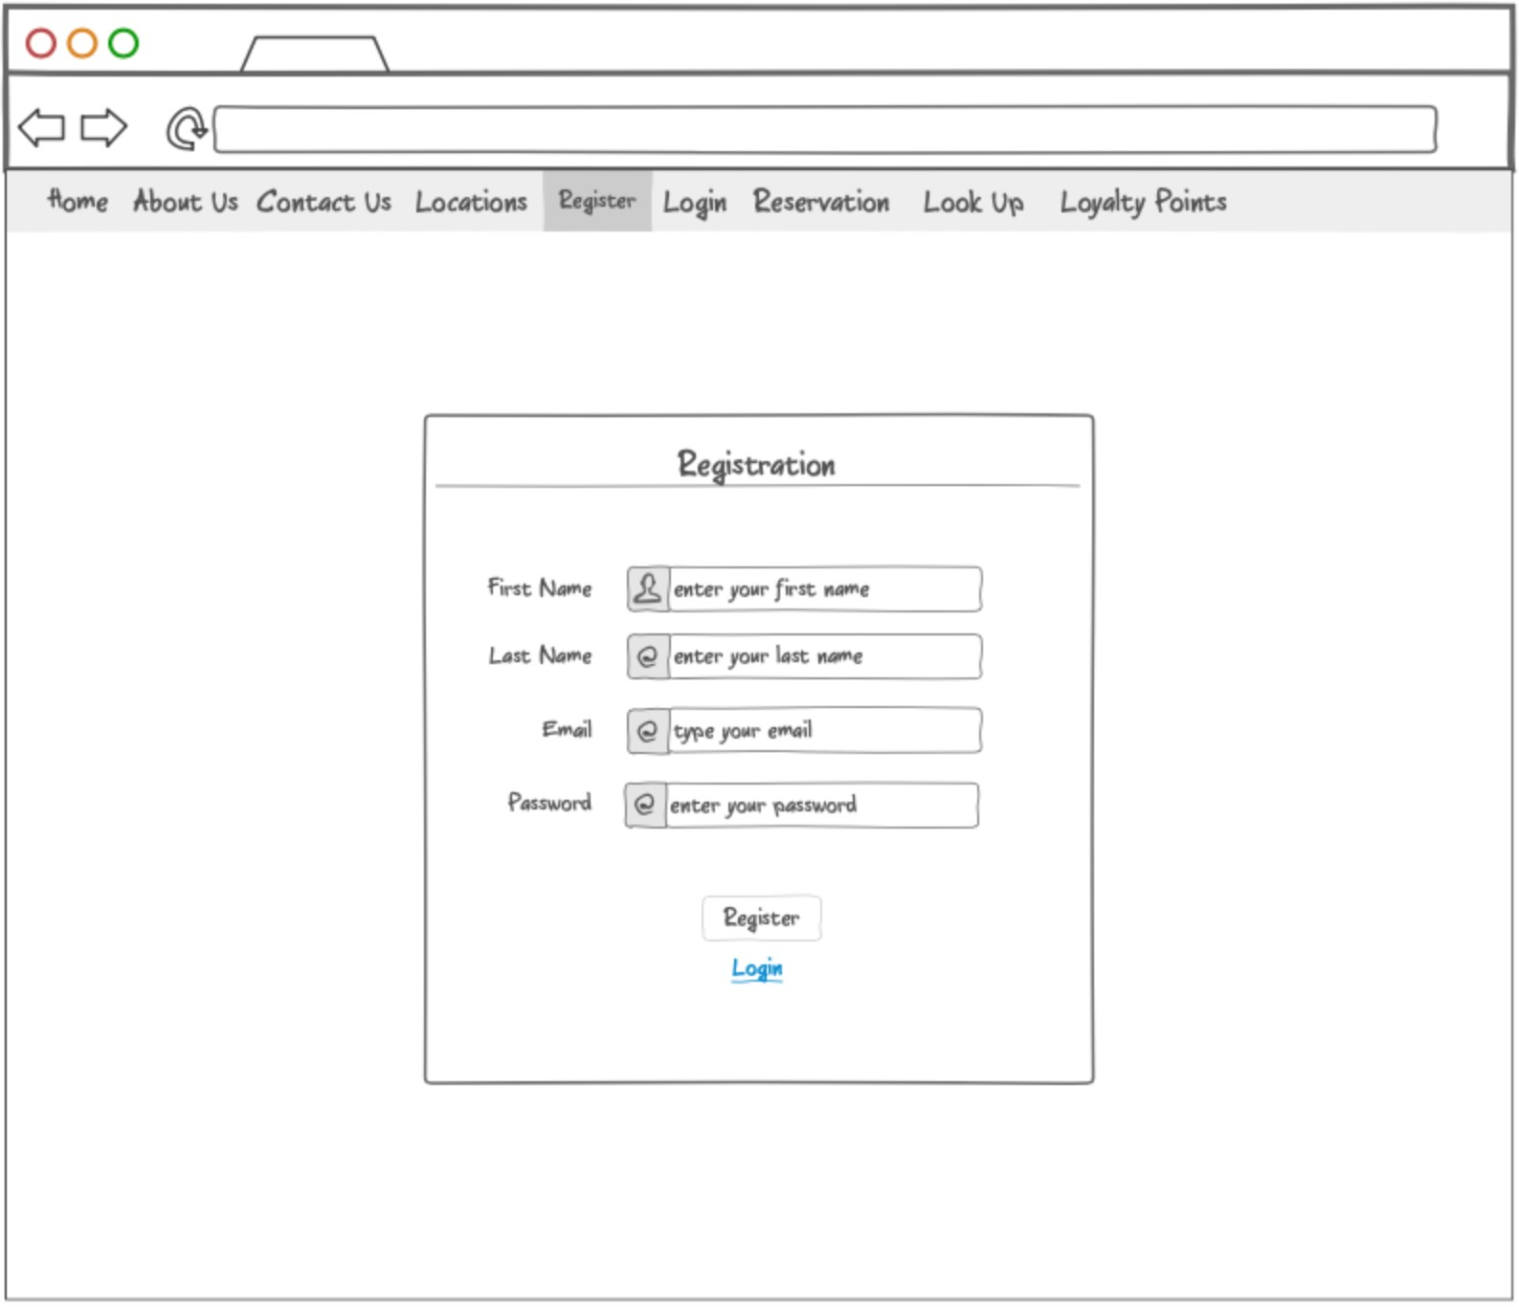
Registration Page prototype

Slide 7
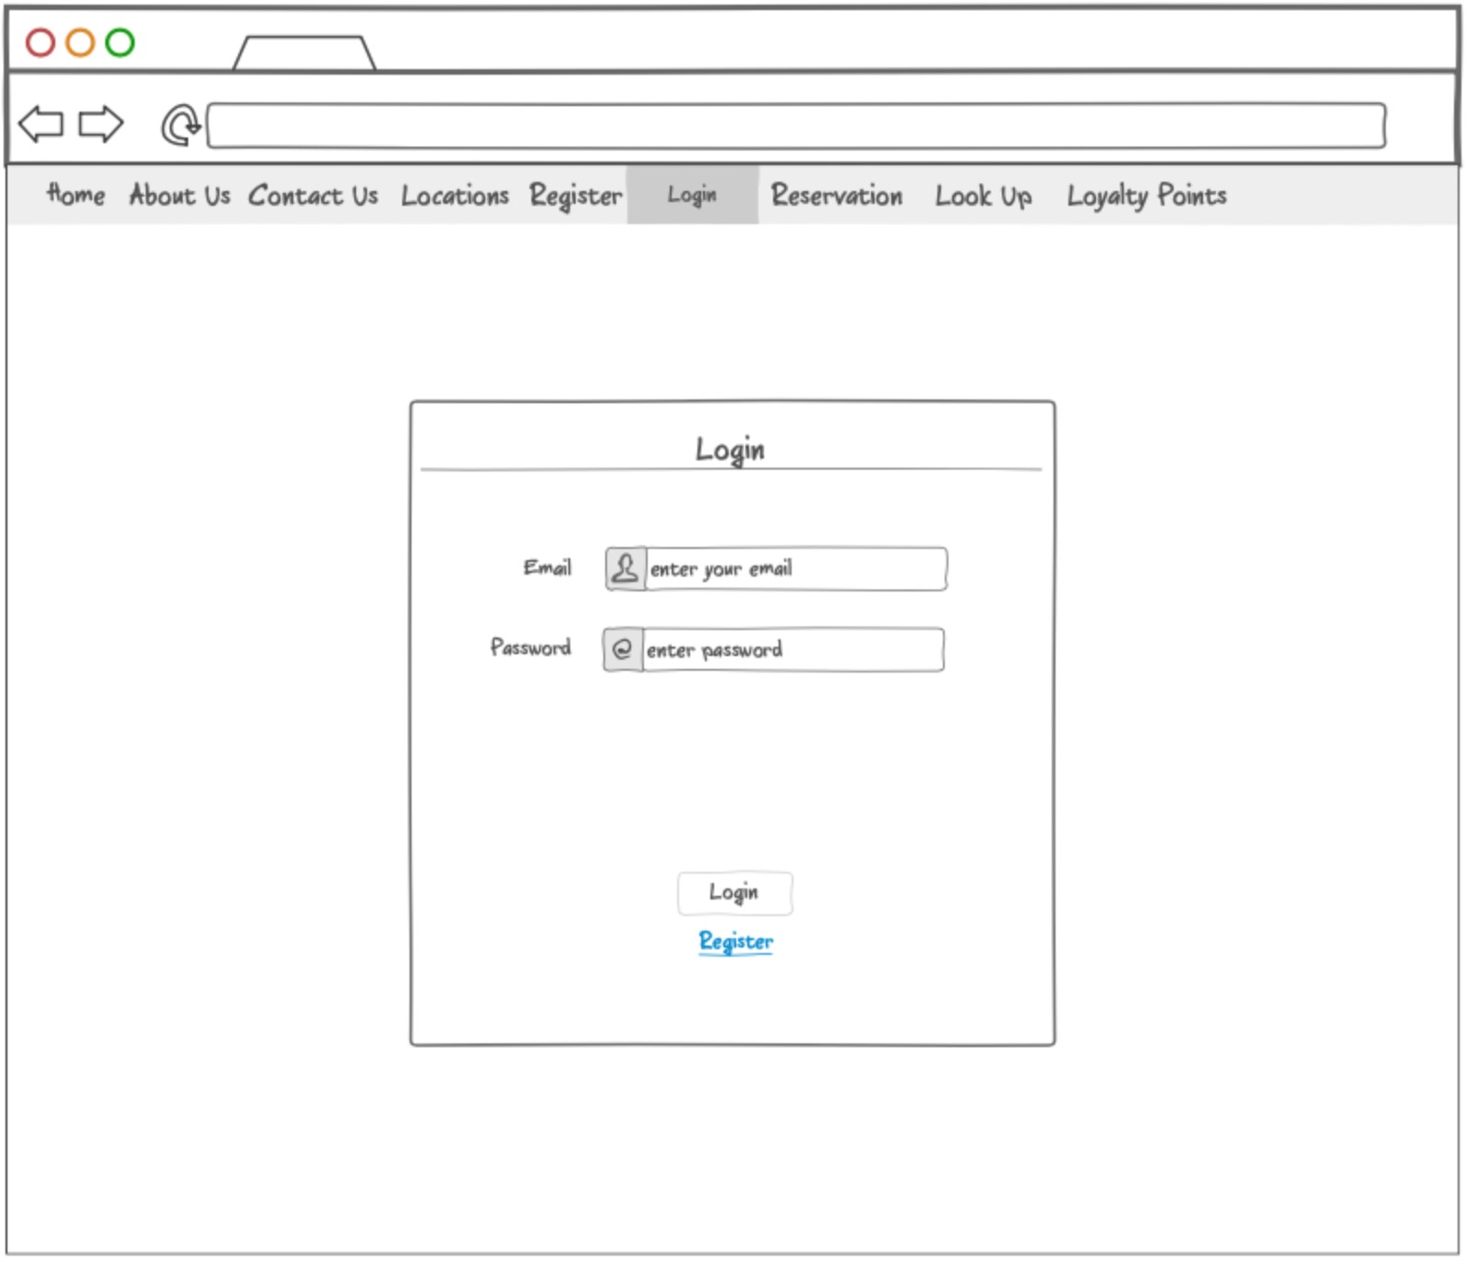
login Page prototype

Slide 8
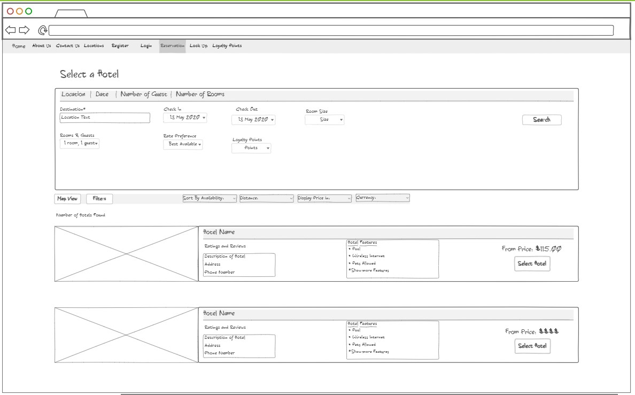
Reservations Page prototype

Slide 9
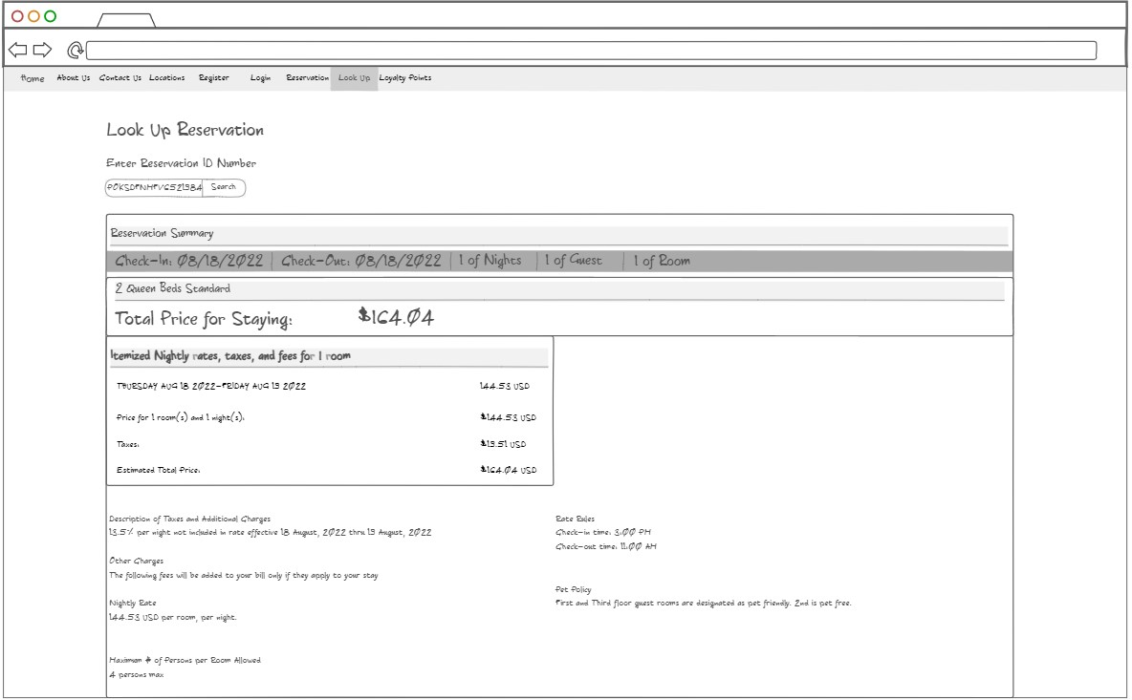
Look up reservation Page prototype

Slide 10
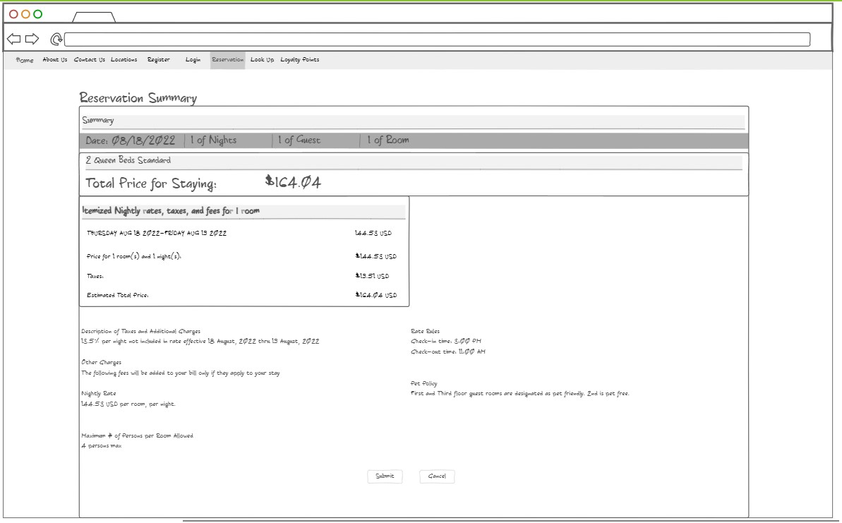
reservation Summary Page prototype

Slide 11
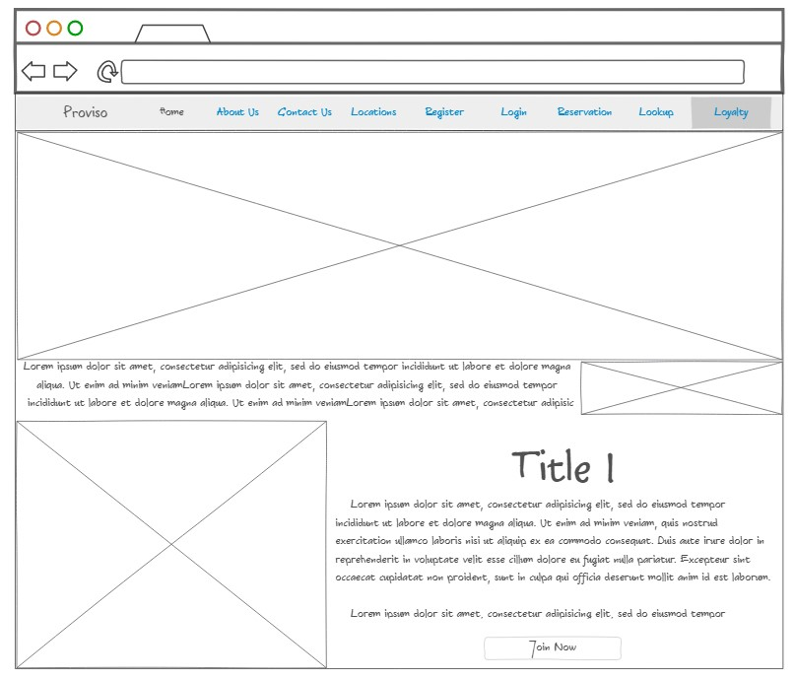
Loyalty Poitns Page prototype

Slide 12
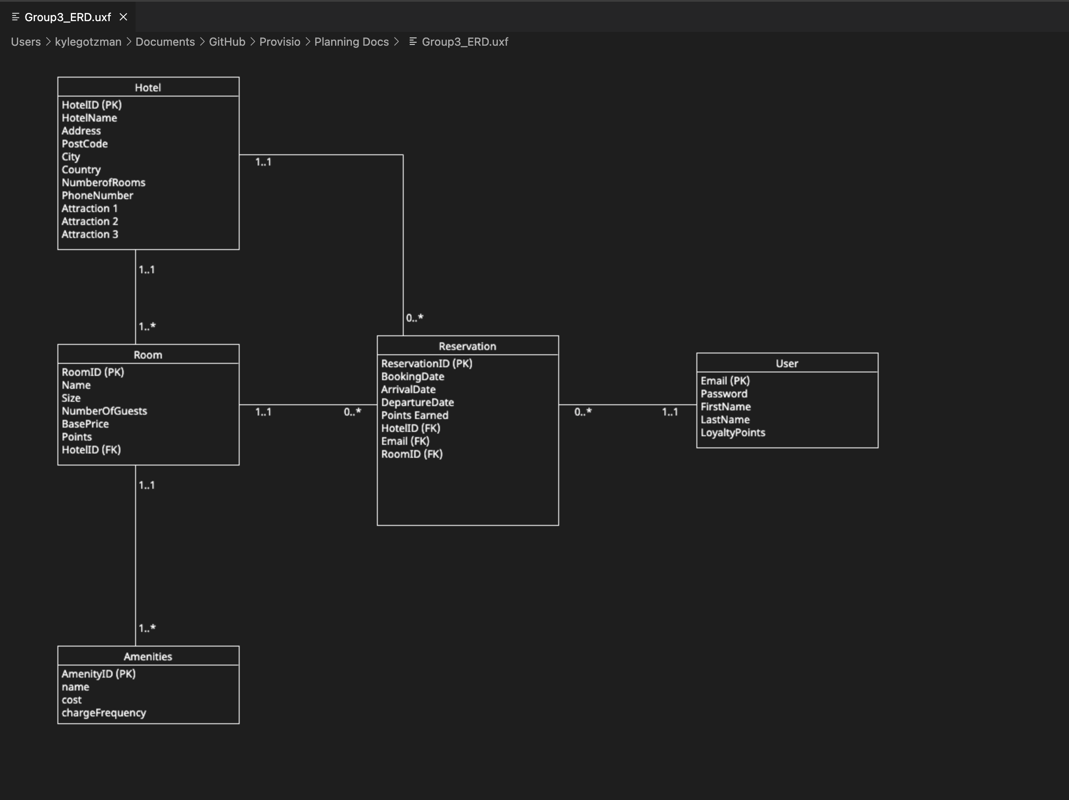
Erd

Slide 13
Test 1: View and cycle through the images
Cycle through images by clicking on the arrows of the images

Slide 14
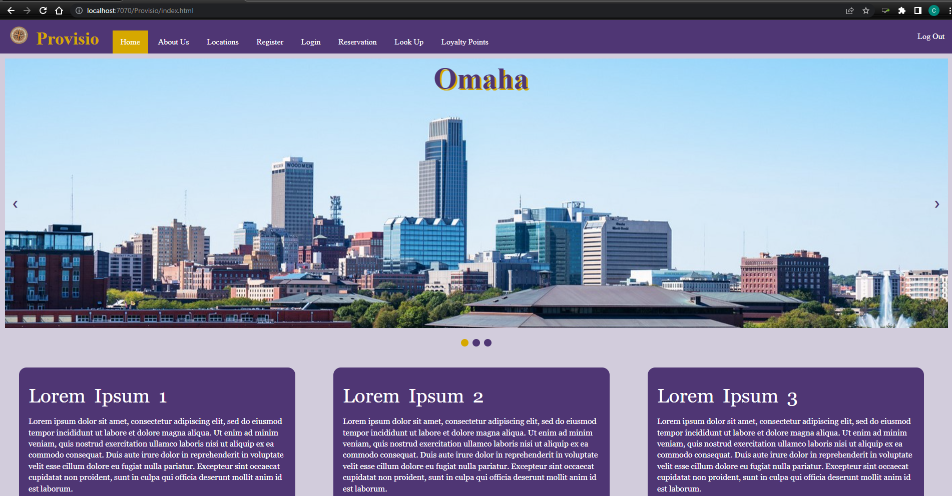
Test 1: View and cycle through the images

Slide 15
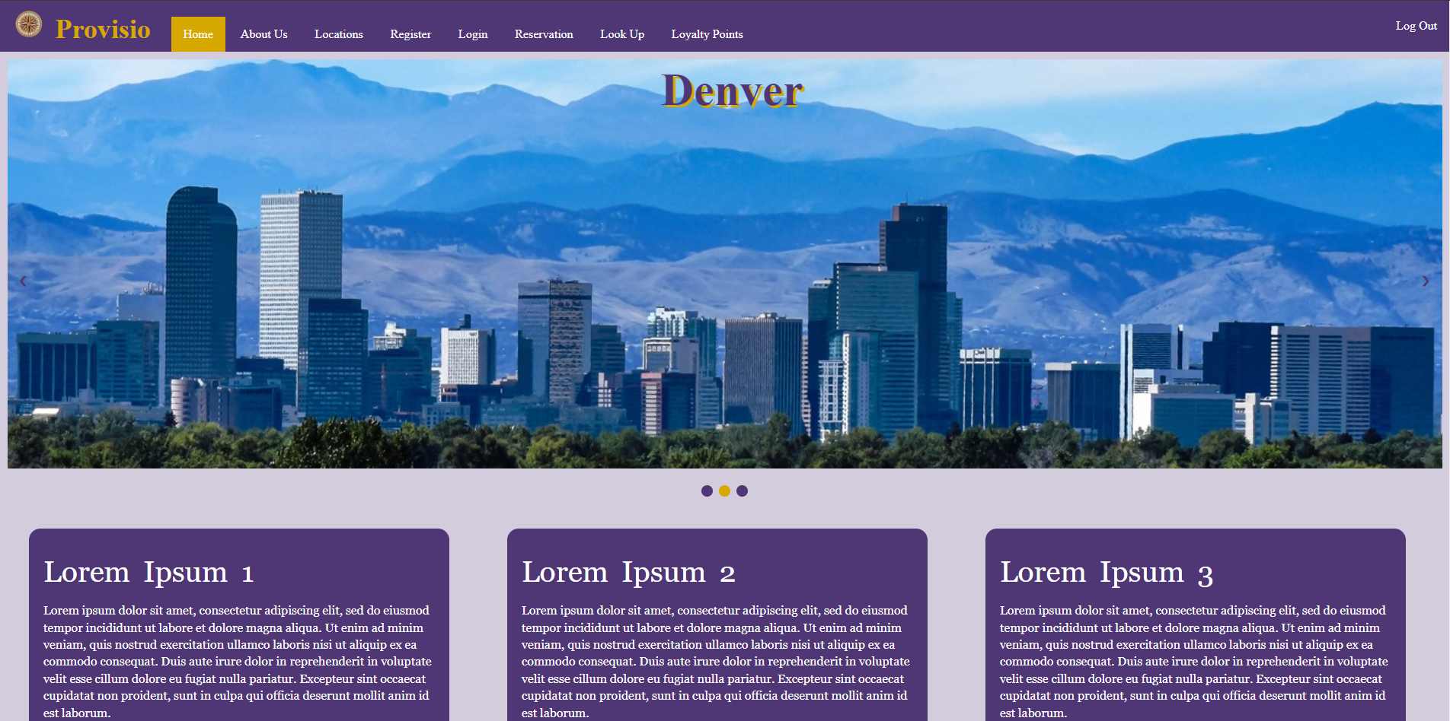
Test 1: View and cycle through the images

Slide 16
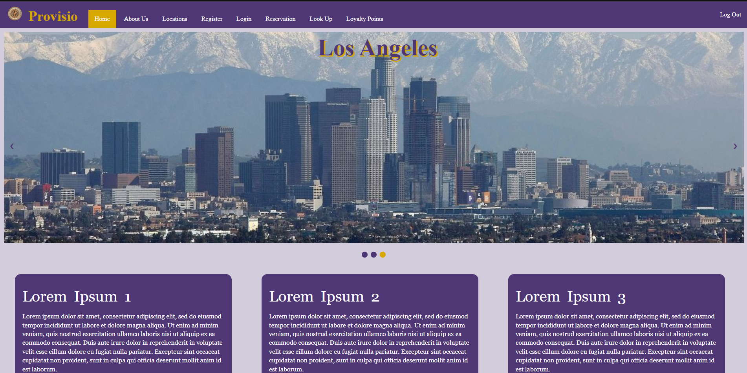
Test 1: View and cycle through the images

Slide 17
Test 1: Pass

Slide 18
Test 2: View loyalty points
Once the user is logged in, click on the loyalty points tab
On the Loyalty page, view the number of points the current user has

Slide 19
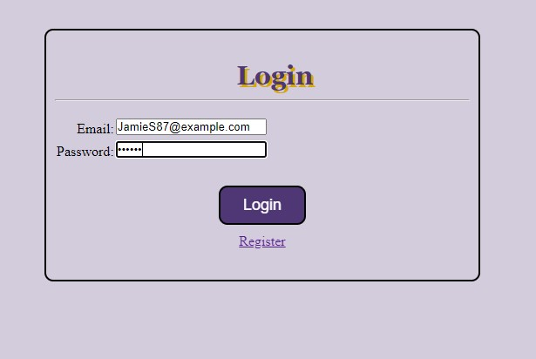
Test 2: View loyalty points
Log In

Slide 20
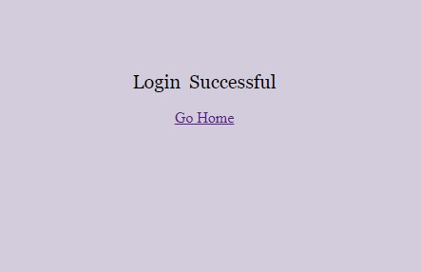
Test 2: View loyalty points
Login Success

Slide 21
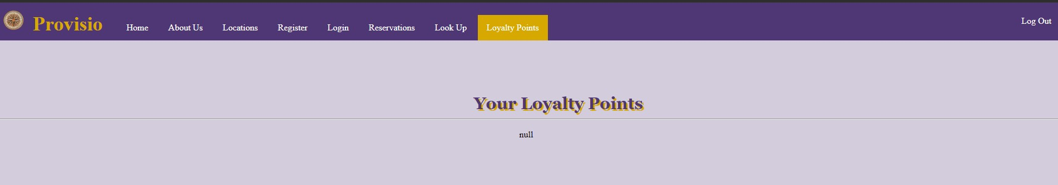
Test 2: View loyalty points
Loyalty points return null

Slide 22
Test 2: fail needed to query the database to find the user associated with the session id and then return how many loyalty points that user had from the database

Slide 23
Test 3: Successfully login with correct username and password
Try to login with preexisting account

Slide 24
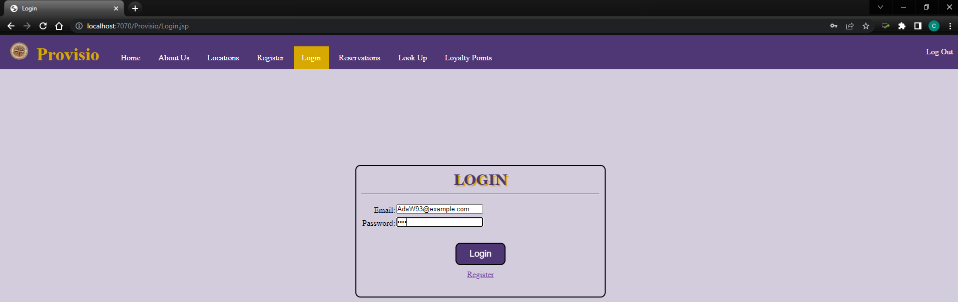
Test 3: Successfully login with correct username and password
Type user’s email and password into login textbox

Slide 25
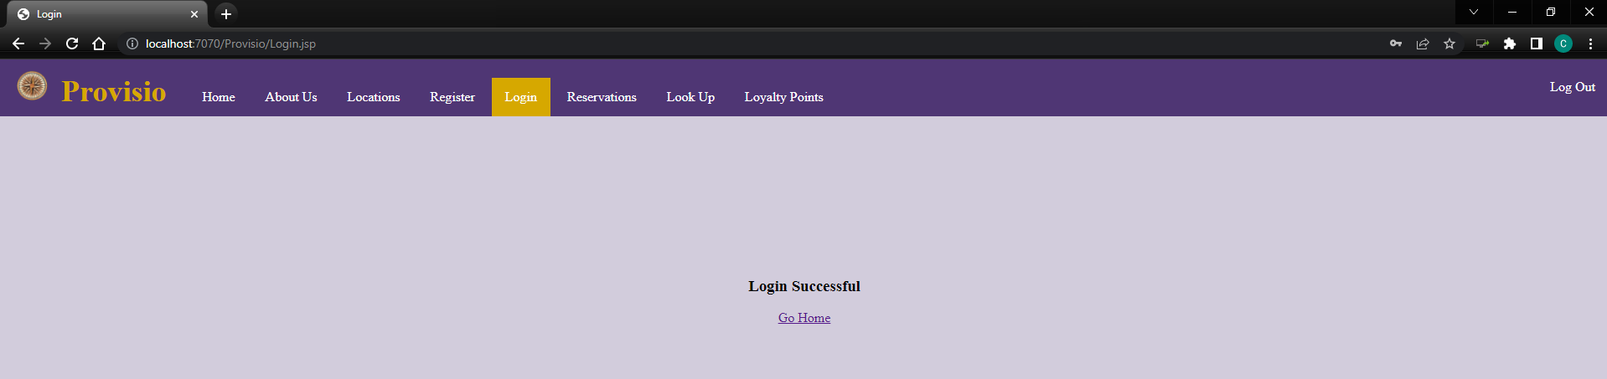
Test 3: Successfully login with correct username and password
Upon clicking the Login Button, user should be notified that they have logged in successfully

Slide 26
Test 3: Pass

Slide 27
Test 4: Successfully register to the site with the correct information
Register an account on the registration page
Go to the login page to log in and see if registration was successful

Slide 28
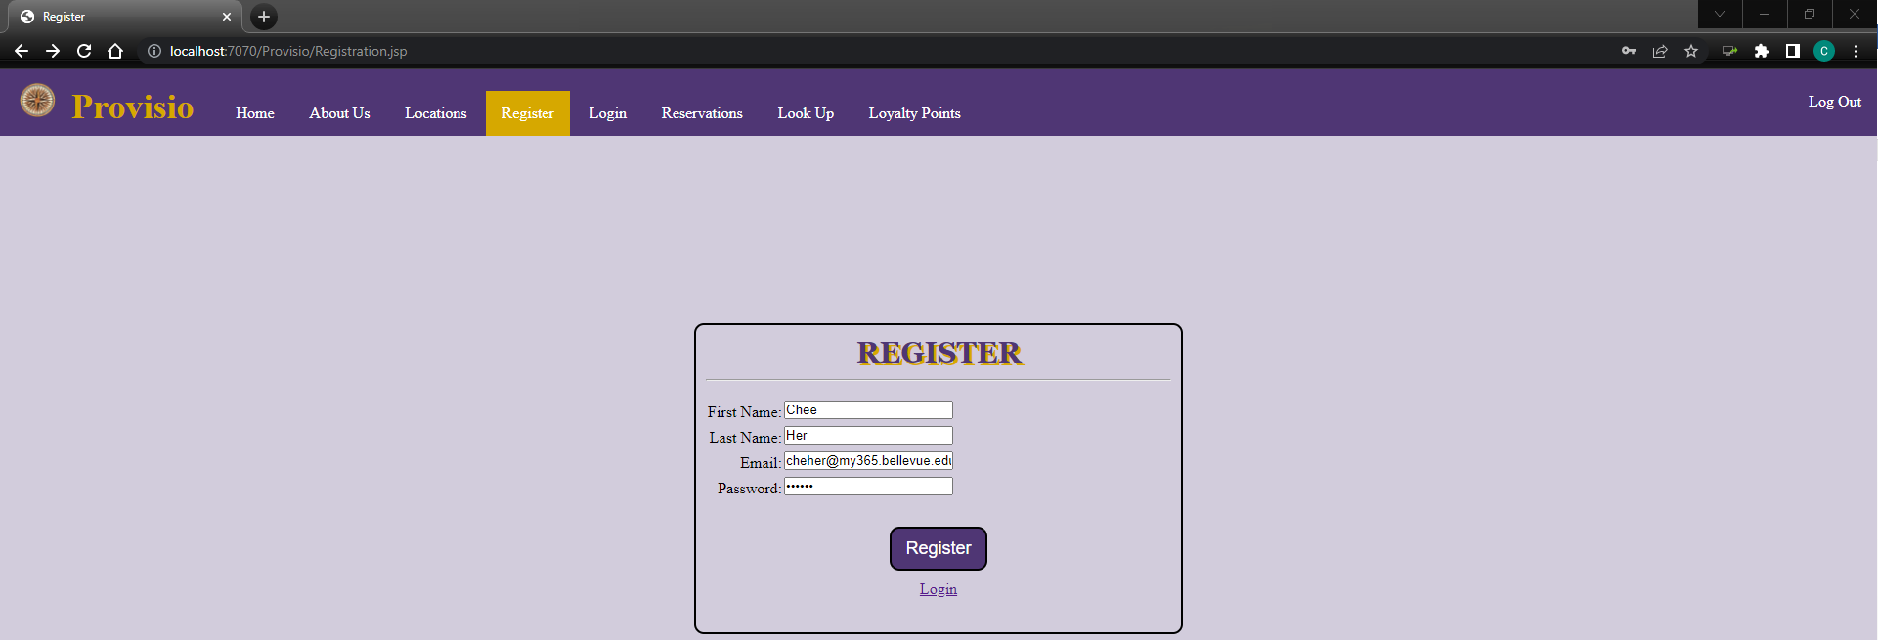
Test 4: Successfully register to the site with the correct information
Fill out the registration form

Slide 29
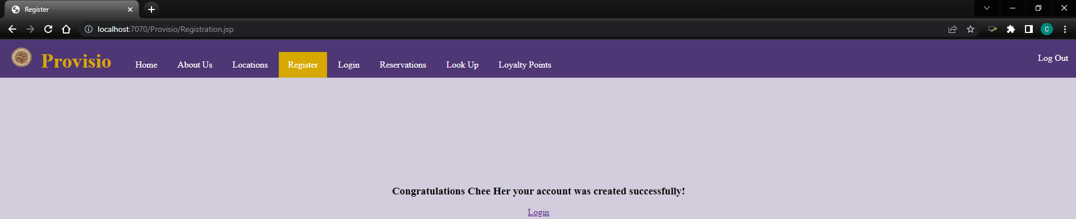
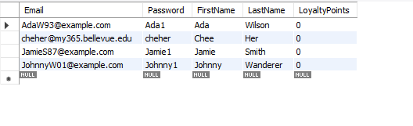
Test 4: Successfully register to the site with the correct information
Entering new credentials into the website allows for the user to be registered

Slide 30
Test 4: Pass

Slide 31
Test 5: Send a message through “Contact us”
User navigates to about us page and fills out contact us form
Success message upon completion

Slide 32
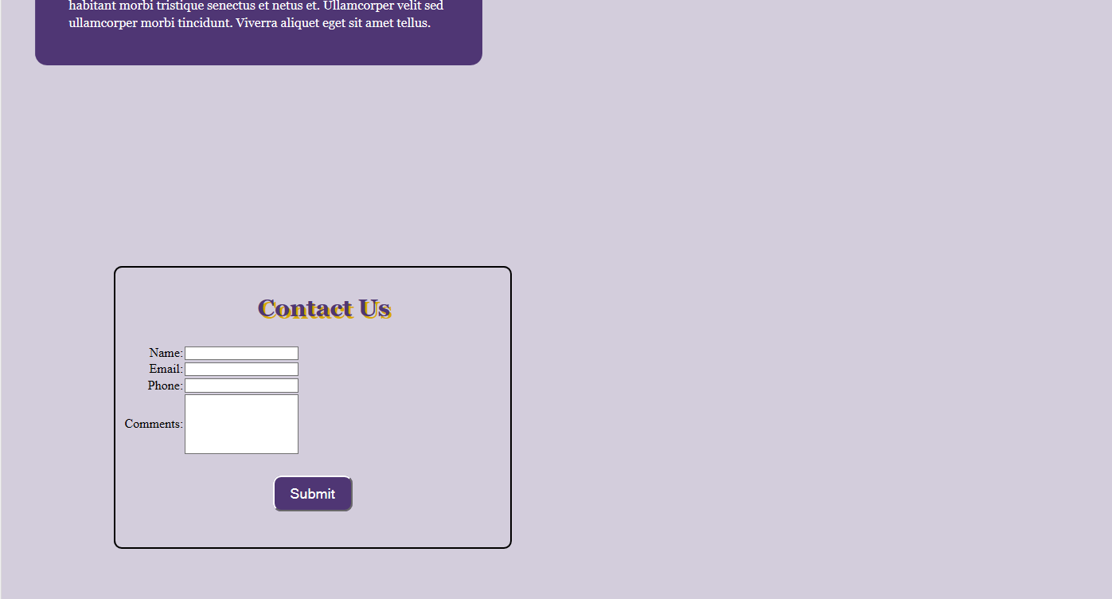
Test 5: Send a message through “Contact us”

Slide 33
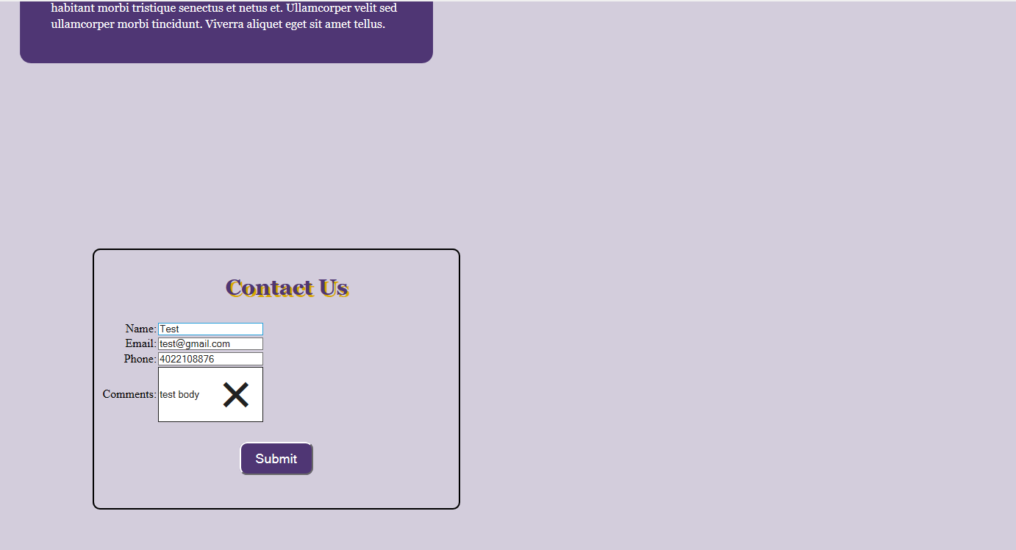
Test 5: Send a message through “Contact us”

Slide 34
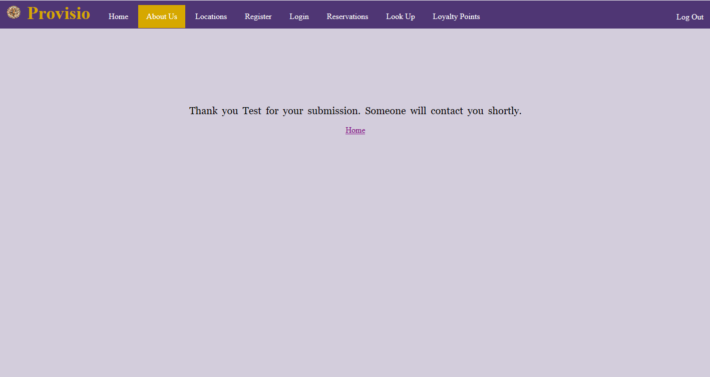
Test 5: Send a message through “Contact us”

Slide 35
Test 5: Pass

Slide 36
Lessons Learned
Group collaboration is crucial in order to create a well working project
Knowing how every page works rather than just the ones you worked on will help with other pages needed to be made in the future
it is important to understand and map out project and programming dependencies to ensure the pages are developed in the correct order
Use of branches in order to maintain stability while isolated changes are made to code

